Slide 1
BLASTNet 流体力学数据集
AI for science的重要数据集！
https://blastnet.github.io/

Slide 2
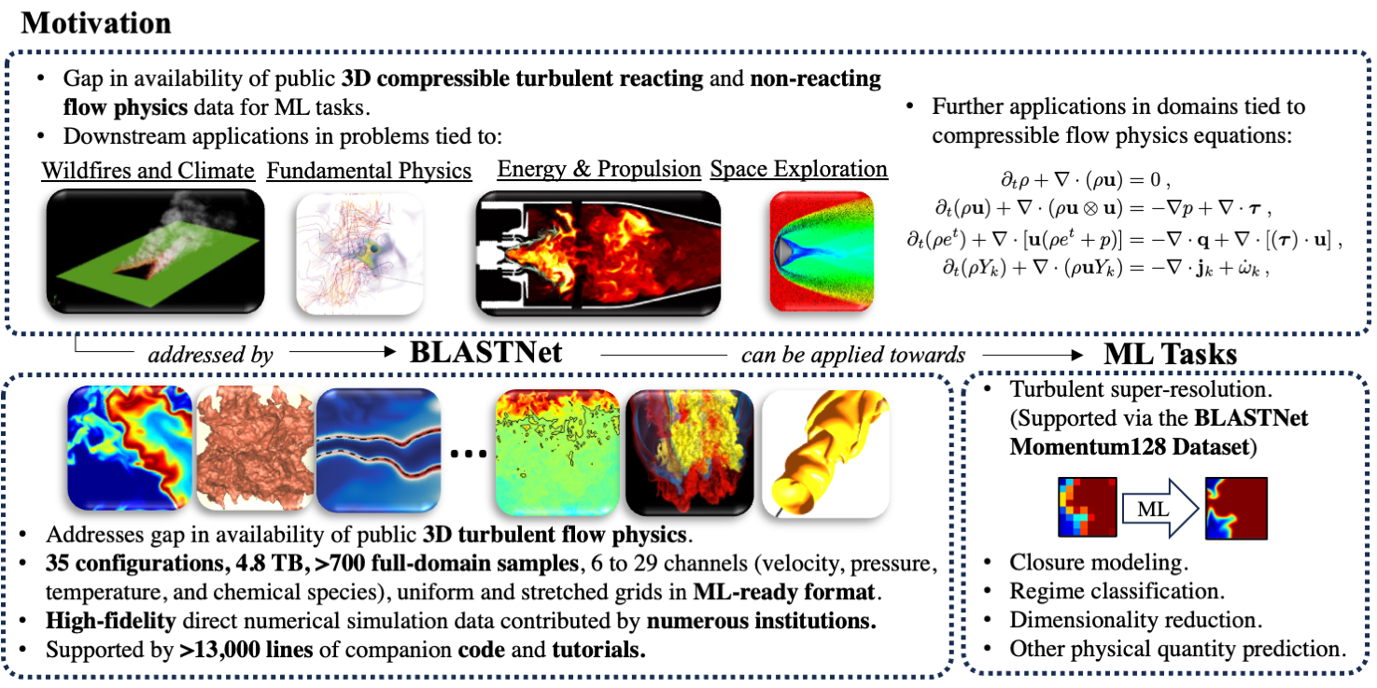
BLASTNet - Motivation

Slide 3
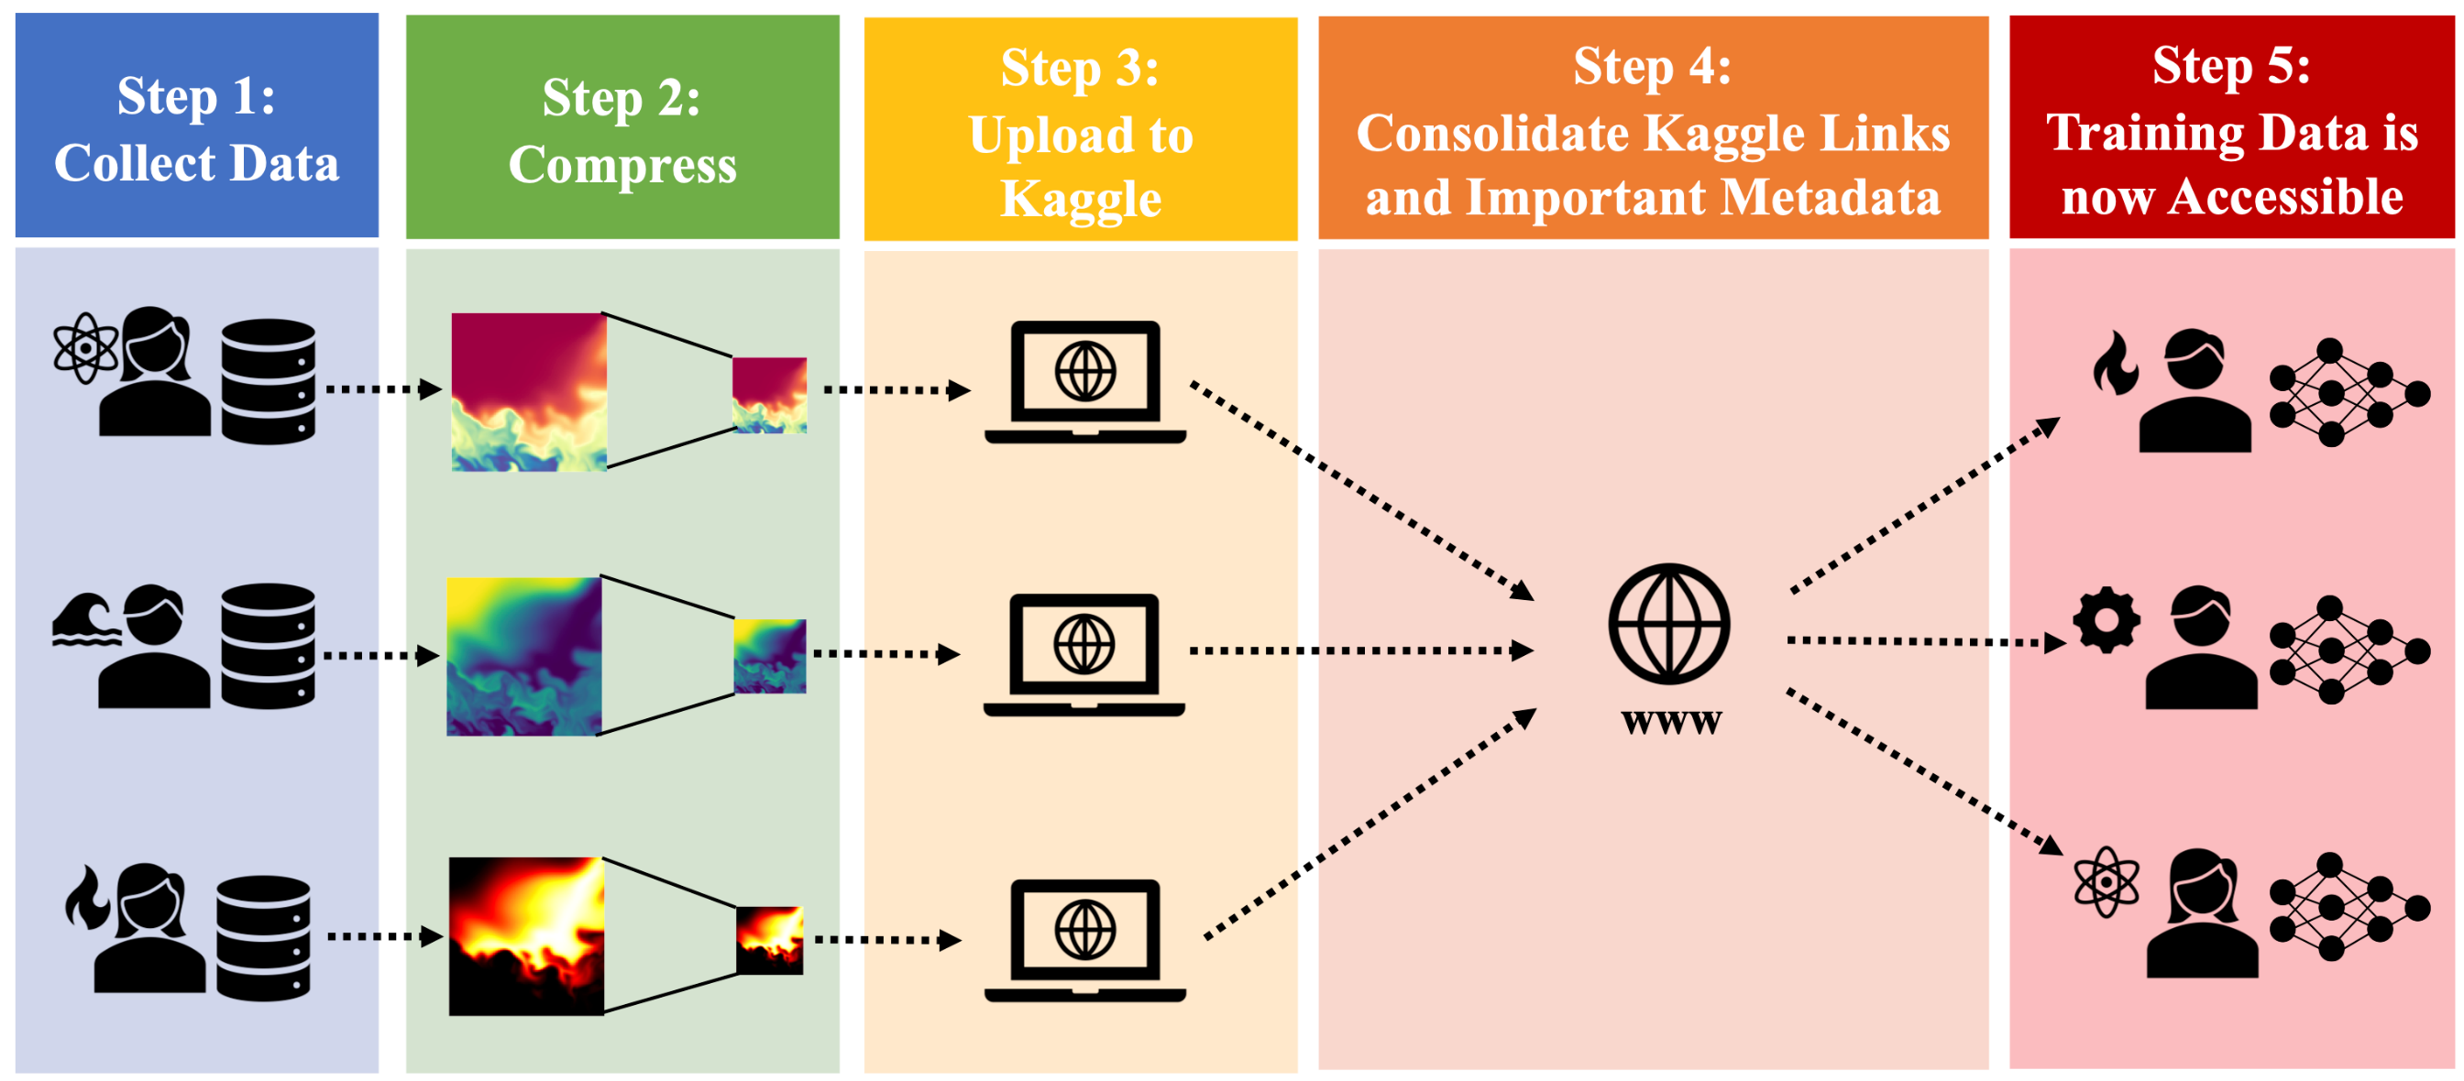
BLASTNet - Distribution

Slide 4
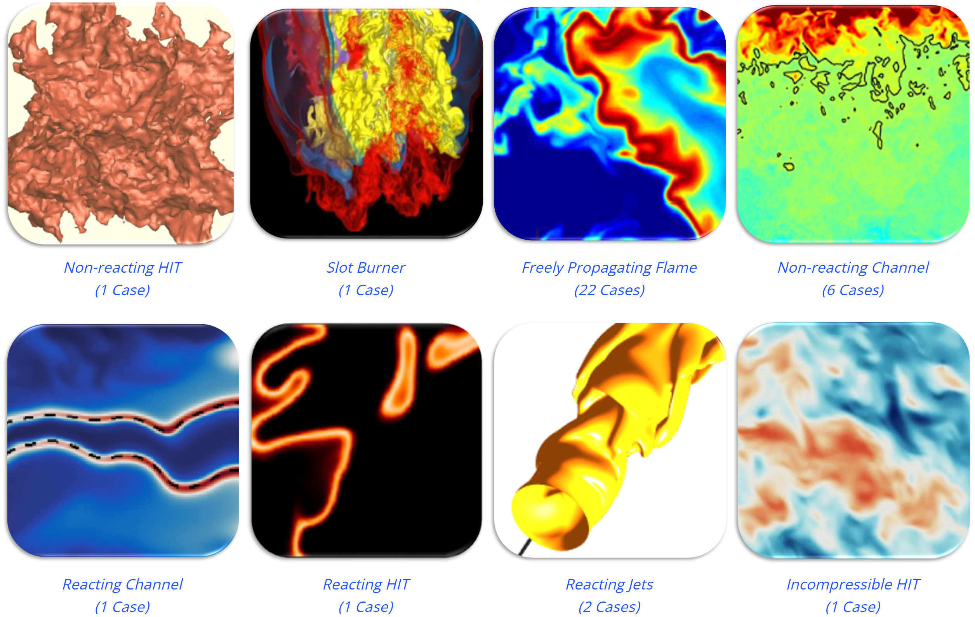
BLASTNet - Dataset Category
BLASTNet Simulation Dataset:

Slide 5
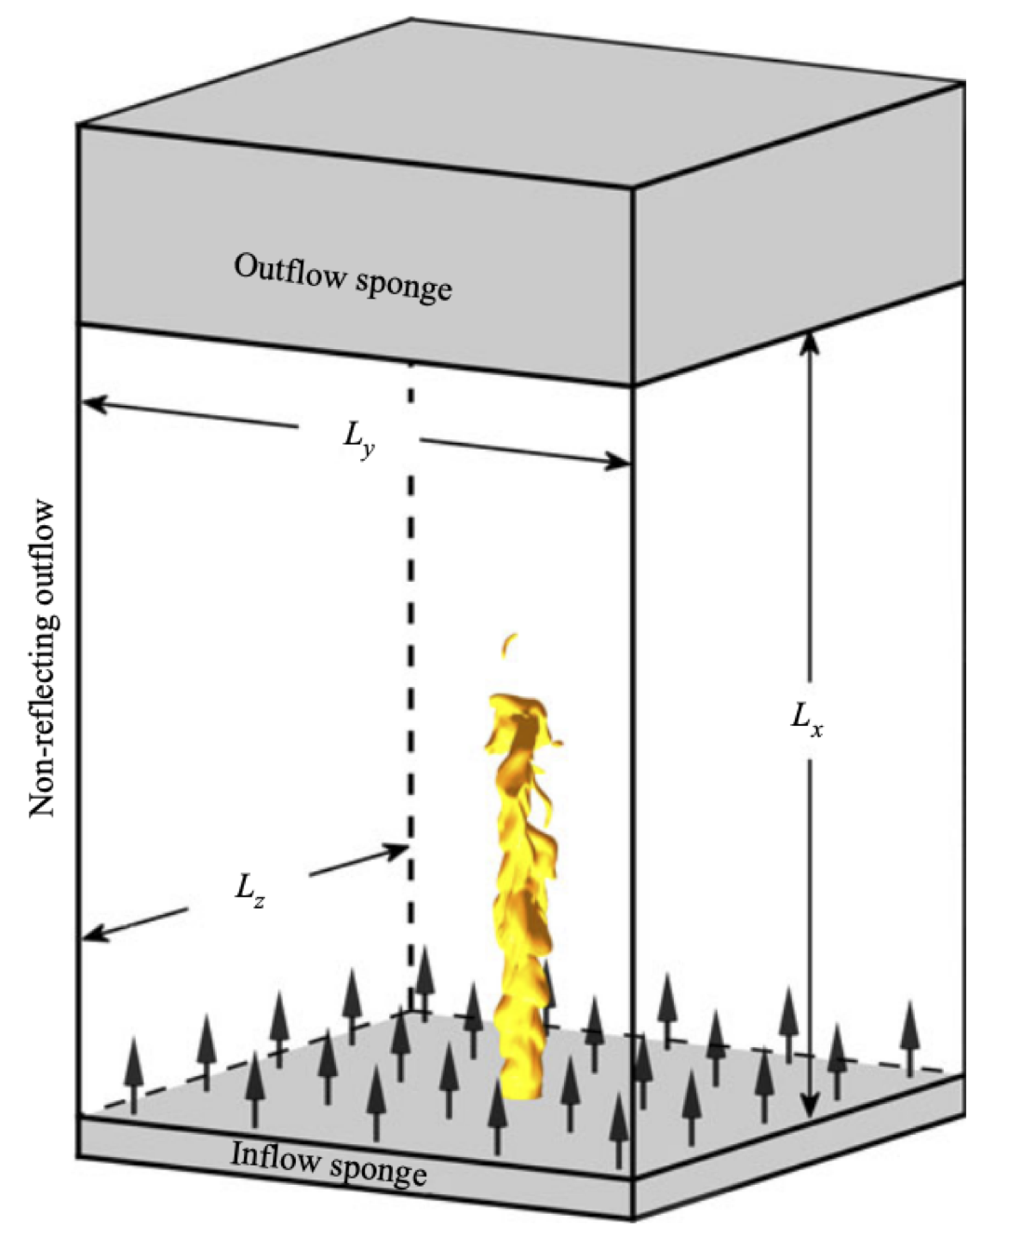
BLASTNet - Example of Simulated Dataset
Reacting Jet Flows ( https://blastnet.github.io/brouzet2021.html )
研究不同化学机制对火焰动力学的影响
执行代码 ：NTMIX-CHEMKIN
求解器：8th –order Explicit Centered Space Difference Scheme & 3rd –order Runge-Kutta

Slide 6
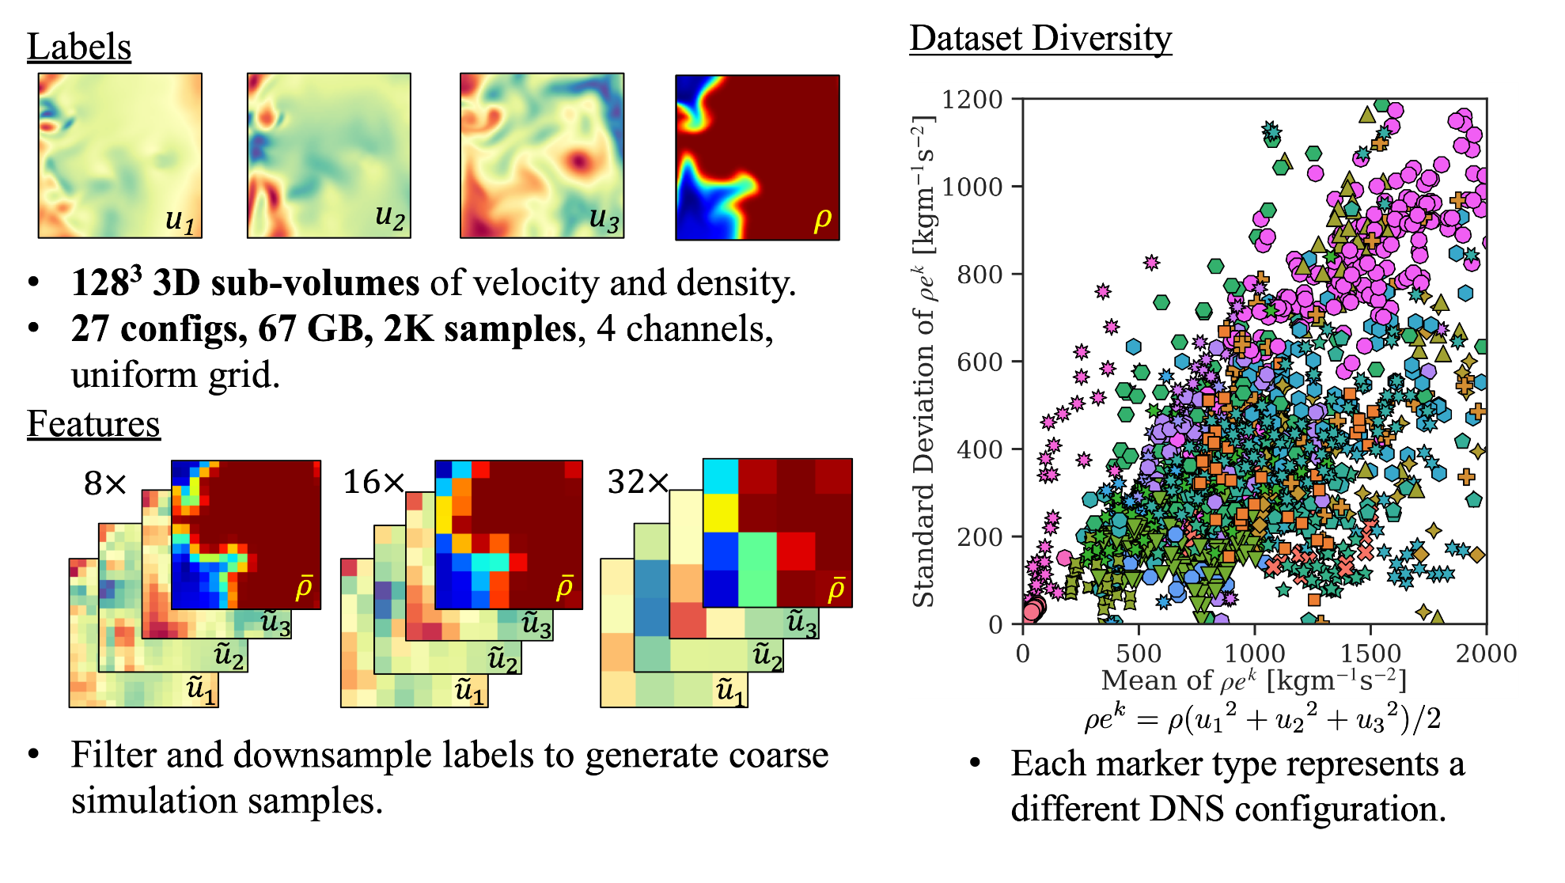
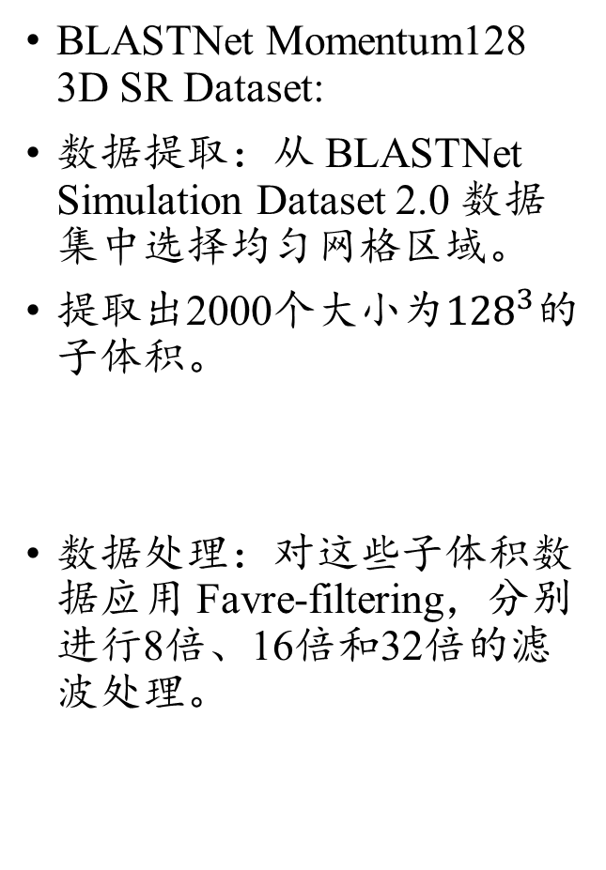
BLASTNet - Dataset Category
BLASTNet Momentum128 3D SR Dataset:
数据提取：从 BLASTNet Simulation Dataset 2.0 数据集中选择均匀网格区域。
提取出2000个大小为${128}^{3}$的子体积。
数据处理：对这些子体积数据应用 Favre-filtering，分别进行8倍、16倍和32倍的滤波处理。

Slide 7
Data-driven discovery of coordinates and governing equations
理解AI for science的重要文章！
许笑颜
xxy1101@mail.ustc.edu.cn

Slide 8
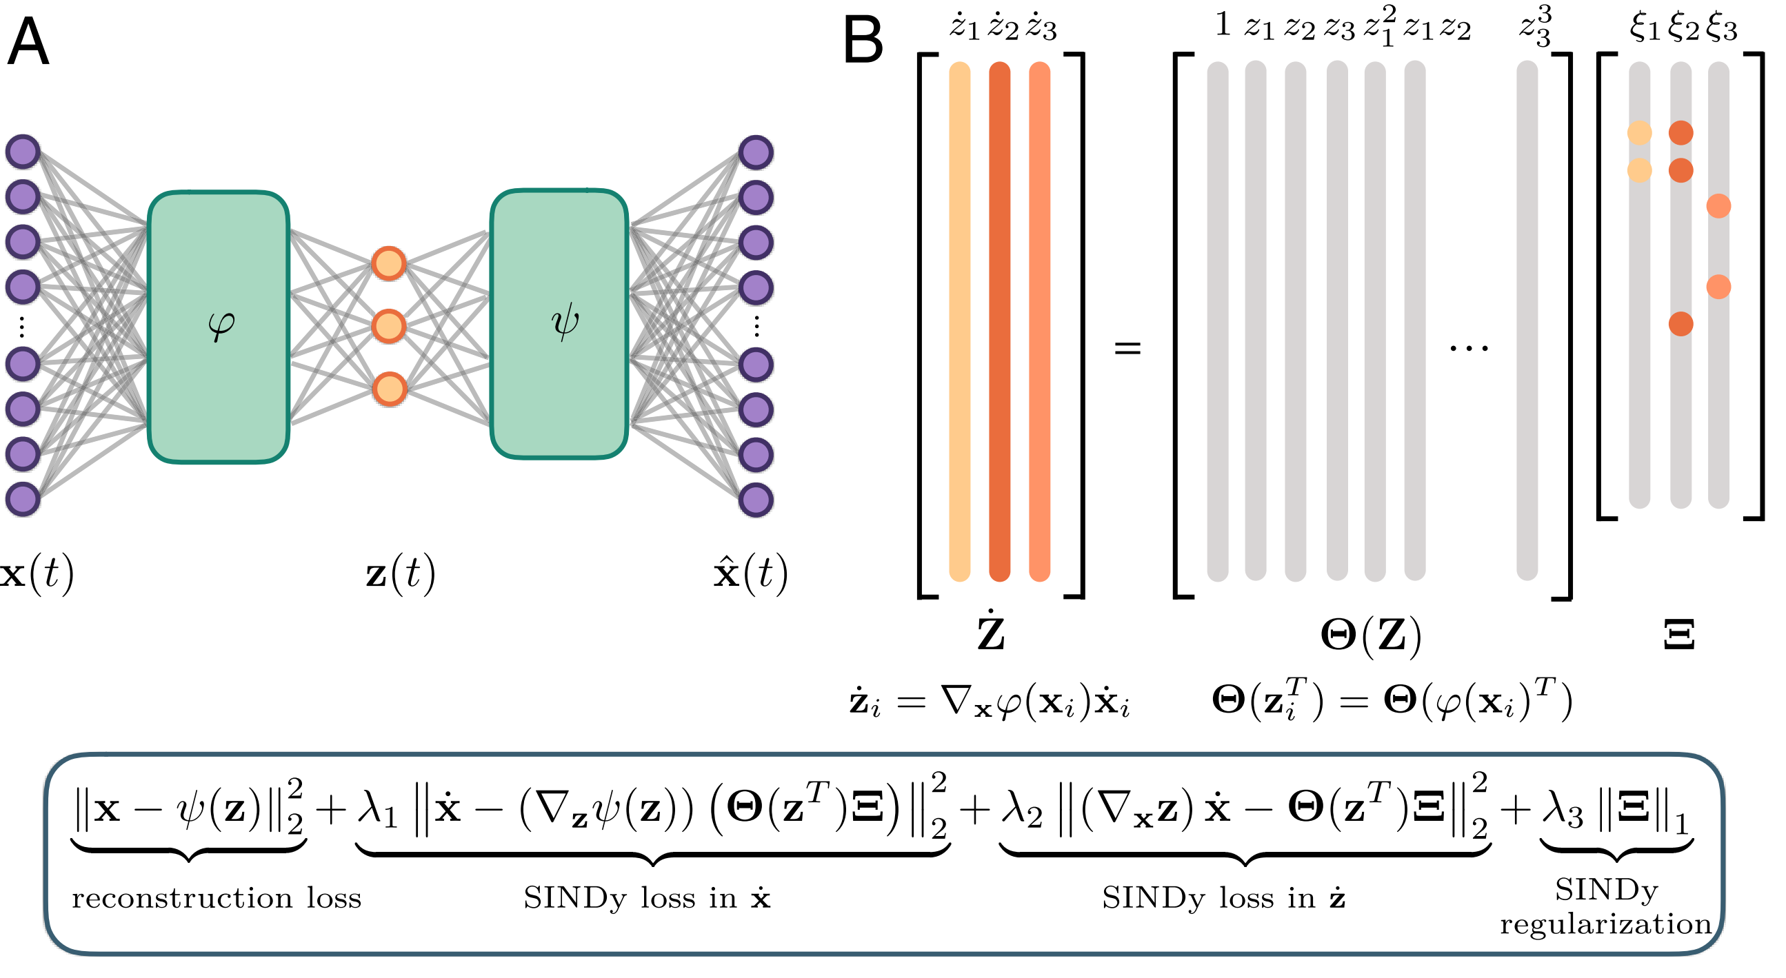
Research Background
How to discover governing equations from scientific data without prior knowledge ?
Conduct coordinate transformation into a reduced space
Identification of both the structure and parameters of nonlinear dynamical systems
Idea:
Design a custom deep autoencoder network
Discover a coordinate transformation into a reduced space.
Thus the dynamics may be sparsely represented.
About the autoencoder network:
SIND
Encoder & Decoder

Slide 9
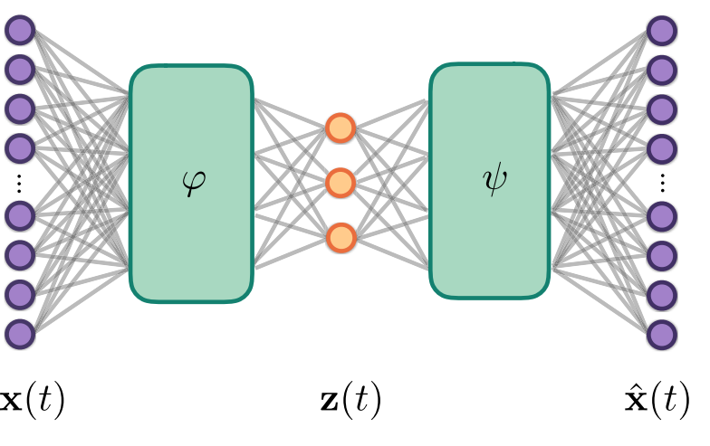
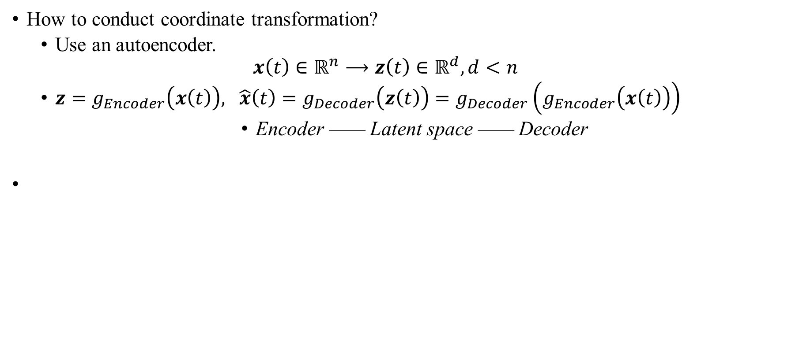
A simple idea
How to conduct coordinate transformation?
Use an autoencoder.
$$x\left(t\right)∈ℝ^{n}⟶z\left(t\right)∈ℝ^{d}, d<n$$
$z=g_{Encoder}\left(x\left(t\right)\right), \hat{x}\left(t\right)=g_{Decoder}\left(z\left(t\right)\right)=g_{Decoder}\left(g_{Encoder}\left(x\left(t\right)\right)\right)$
Encoder —— Latent space —— Decoder
No guarantee that the intrinsic coordinates learned will have associated sparse dynamical models！

Slide 10
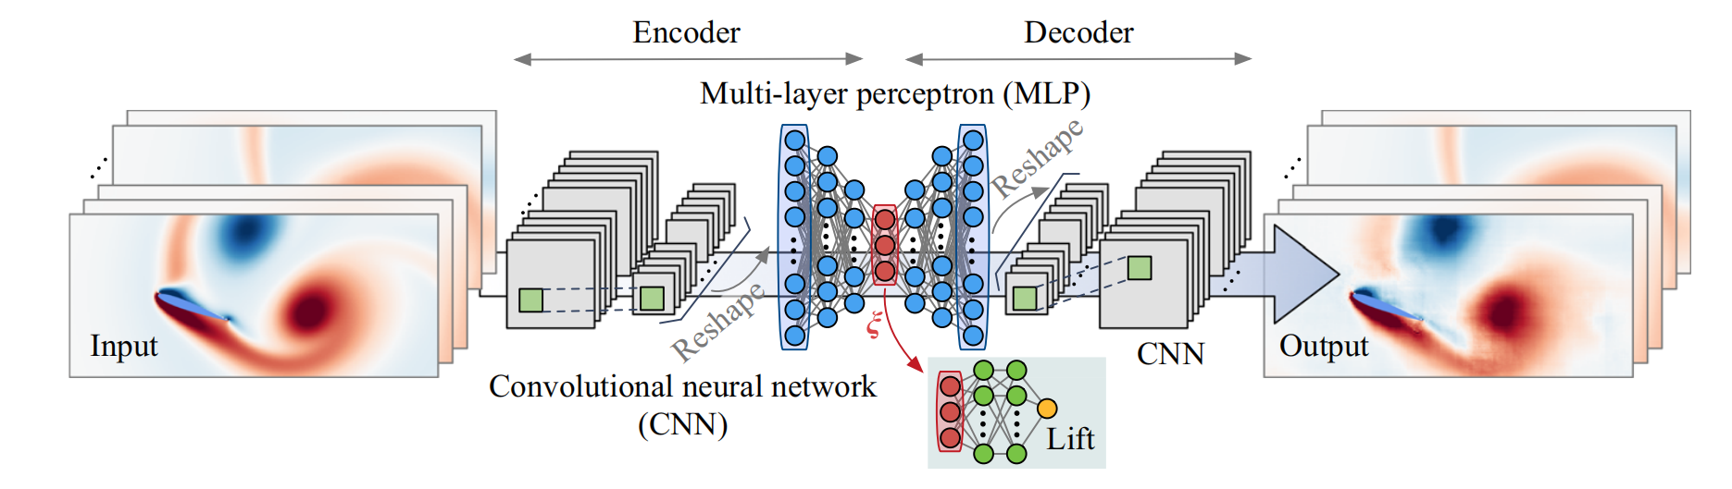
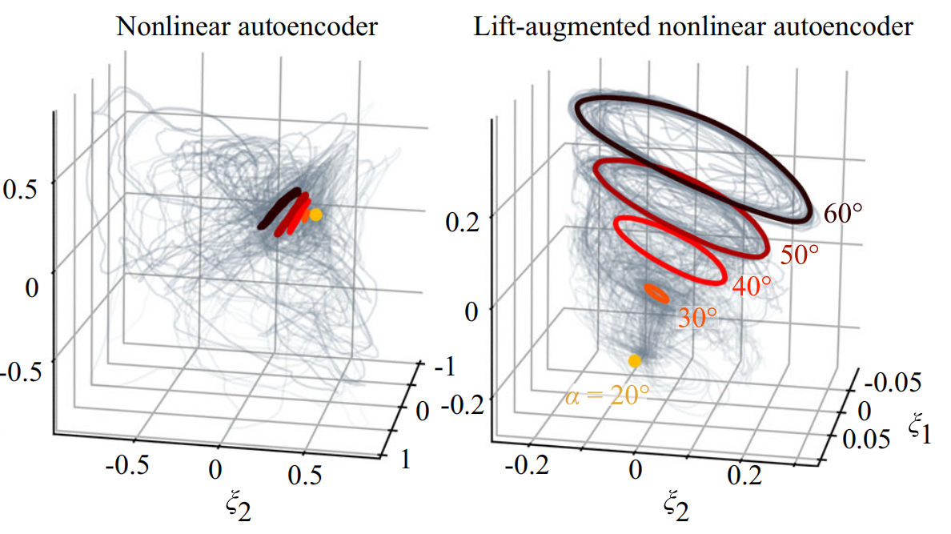
The necessity of physics
Without Physics Prior
With Physics Prior

Slide 11
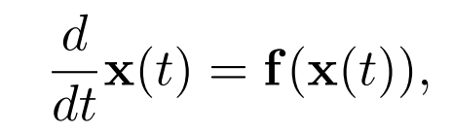
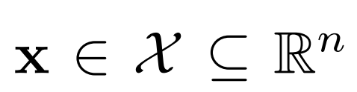
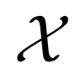
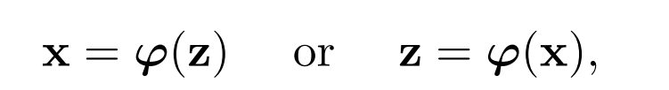
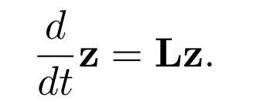
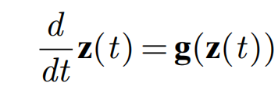
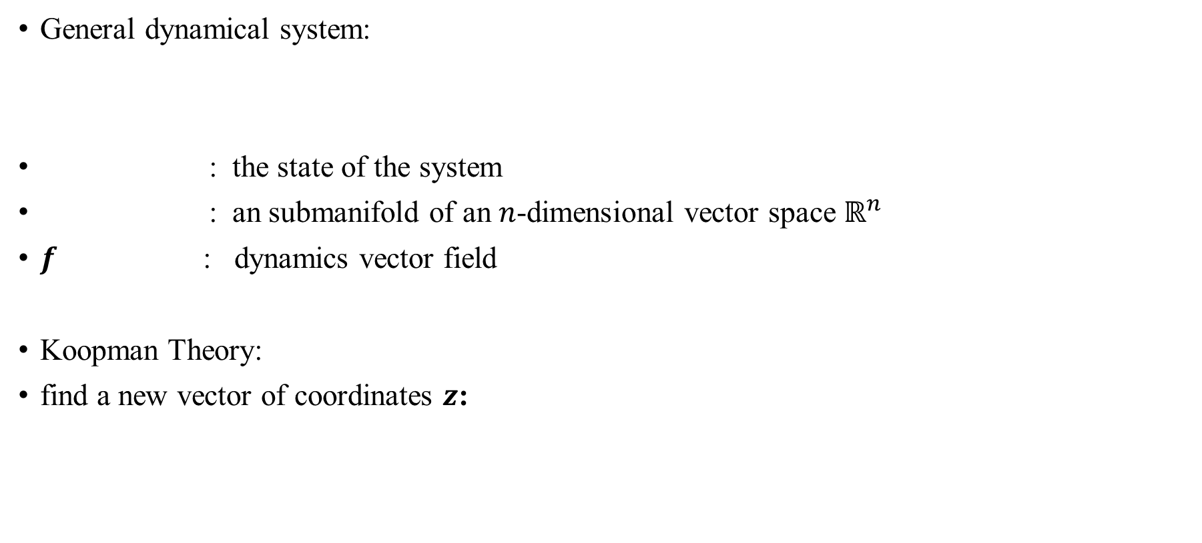

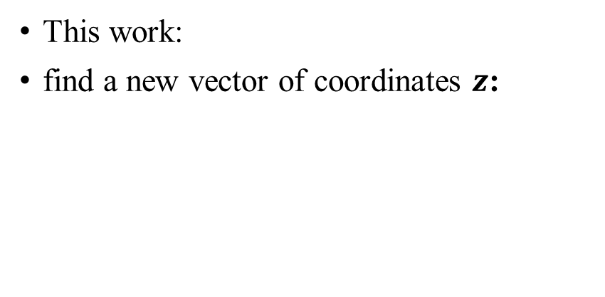

Prior Knowledge
General dynamical system:
: the state of the system
: an submanifold of an $n$-dimensional vector space $ℝ^{n}$
$f$ : dynamics vector field
Koopman Theory:
find a new vector of coordinates $z$:
This work:
find a new vector of coordinates $z$:
Nonlinear $⇒$ Linear!
High-dimension $⇒$ Low-dimension!

Slide 12
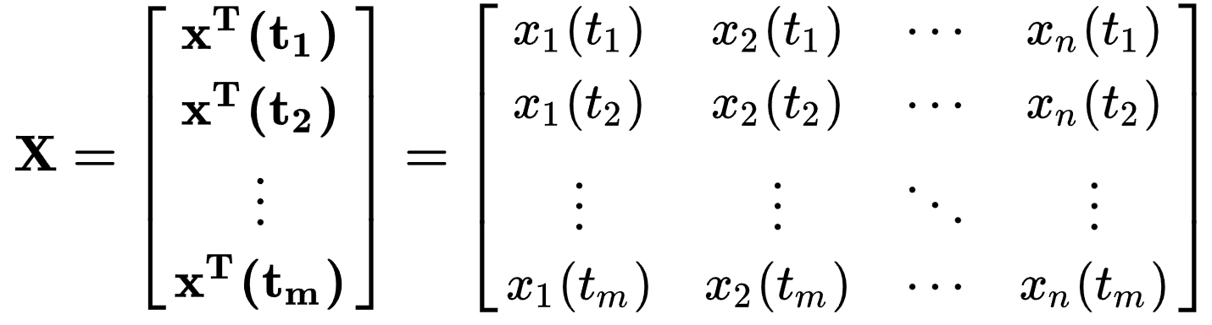
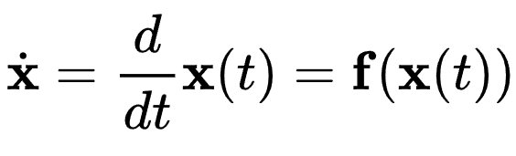
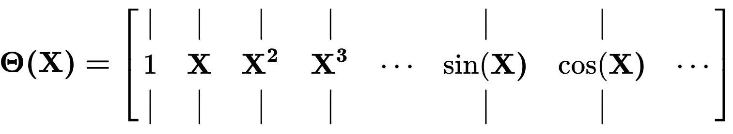
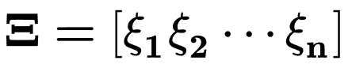

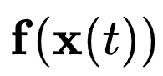

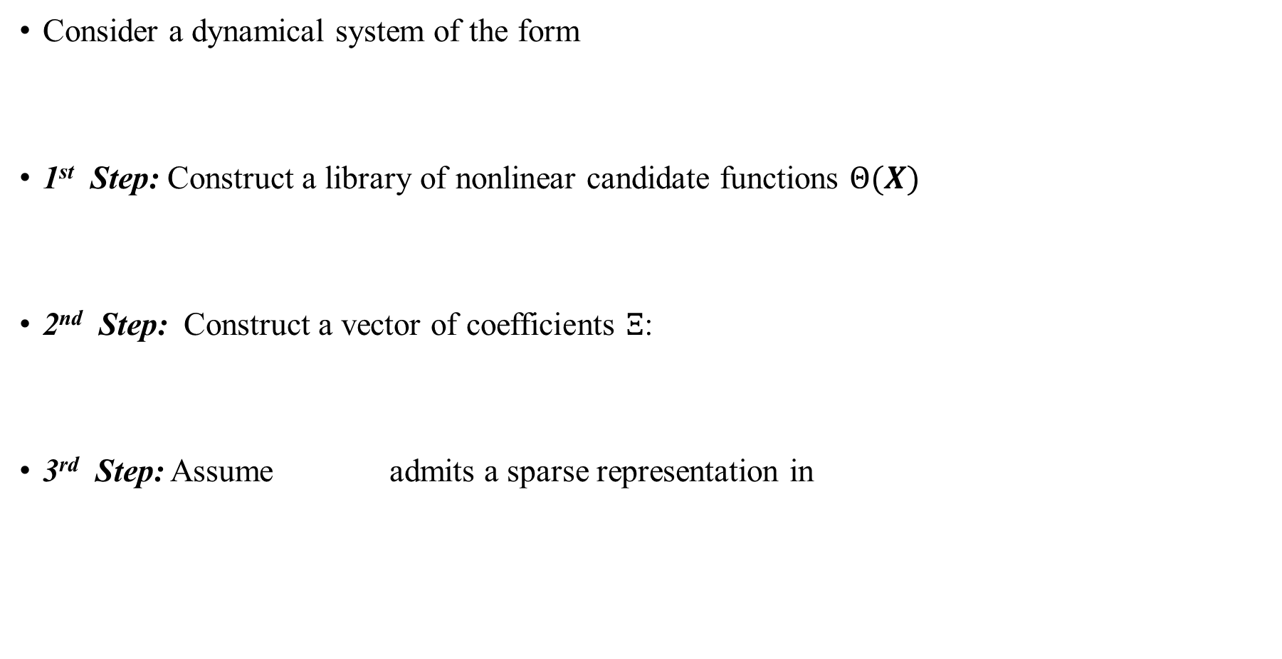
Prior Knowledge - Sparse identification of non-linear dynamics
Consider a dynamical system of the form
1st Step: Construct a library of nonlinear candidate functions $Θ(X)$
2nd Step: Construct a vector of coefficients $Ξ$:
3rd Step: Assume admits a sparse representation in

Slide 13
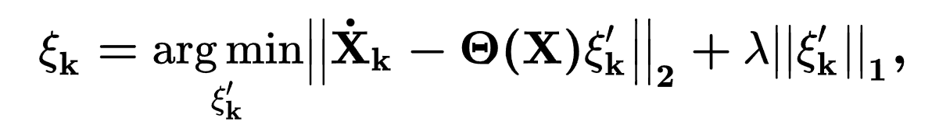
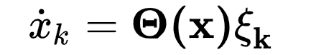
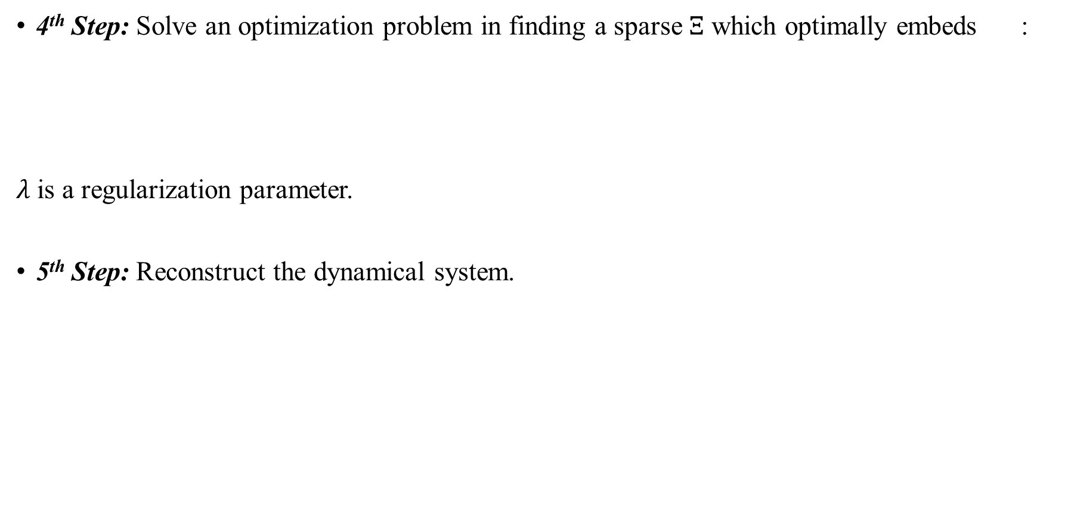
Prior Knowledge - Sparse identification of non-linear dynamics
4th Step: Solve an optimization problem in finding a sparse $Ξ$ which optimally embeds :
$λ$ is a regularization parameter.
5th Step: Reconstruct the dynamical system.
How to solve?
Use least squares regression!

Slide 14
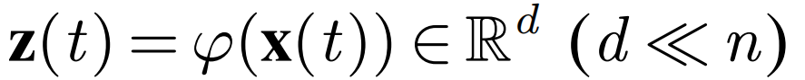
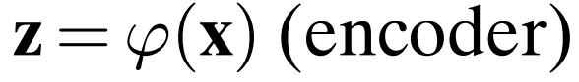
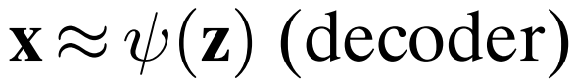
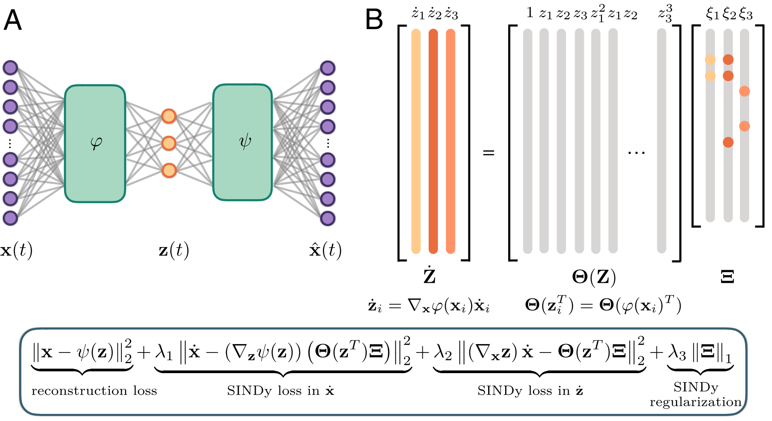
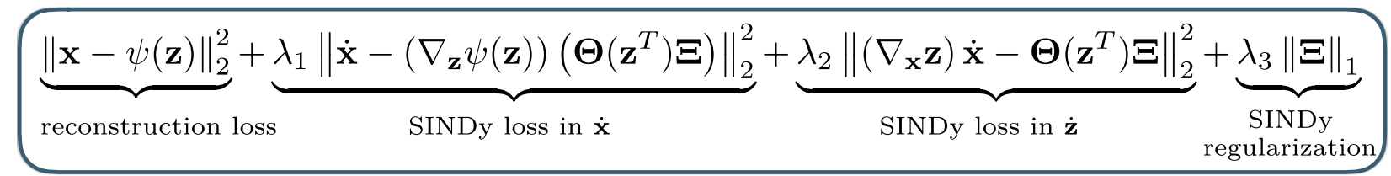
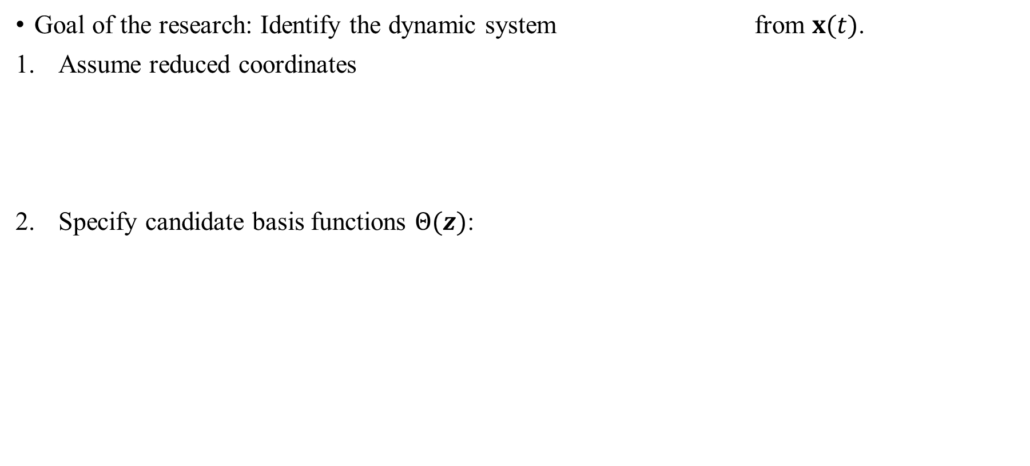
Main Method
Goal of the research: Identify the dynamic system from $x(t)$.
Assume reduced coordinates
Specify candidate basis functions $Θ(z)$:

Slide 15
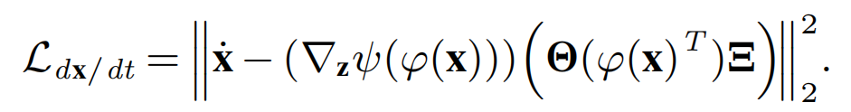
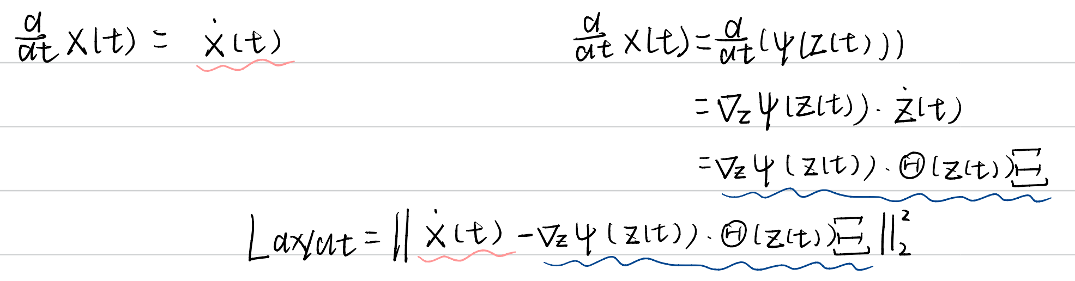
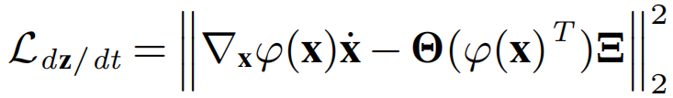
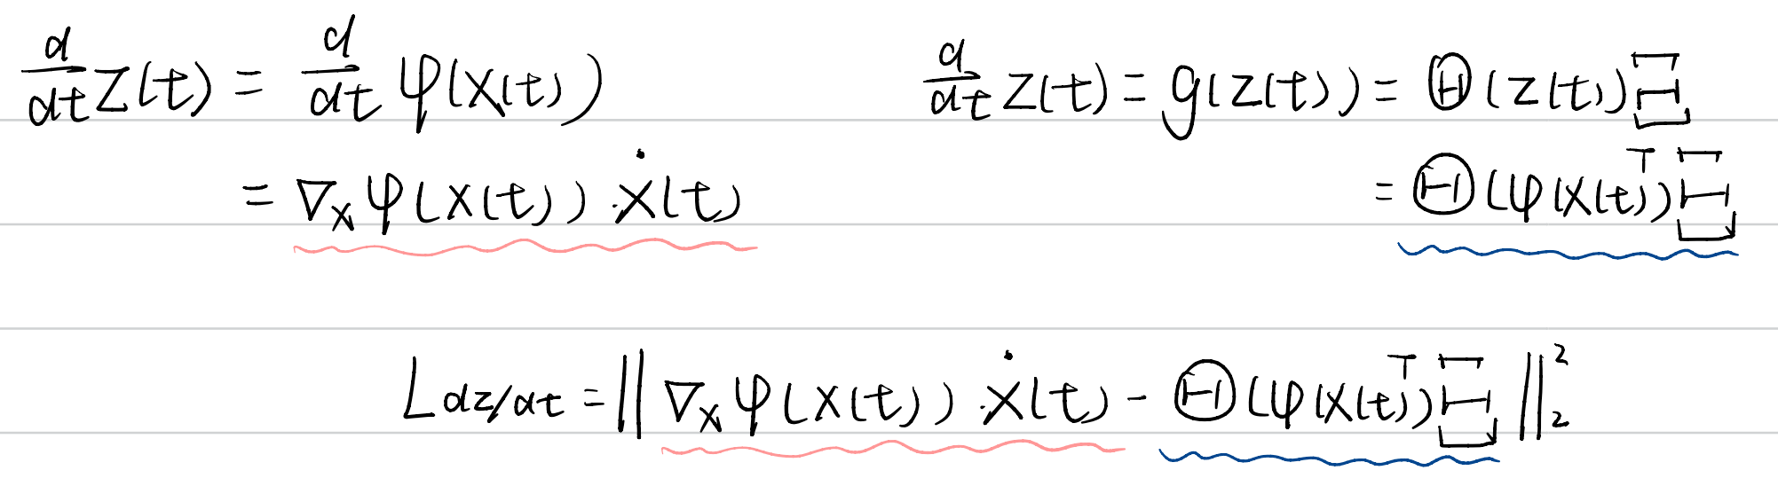
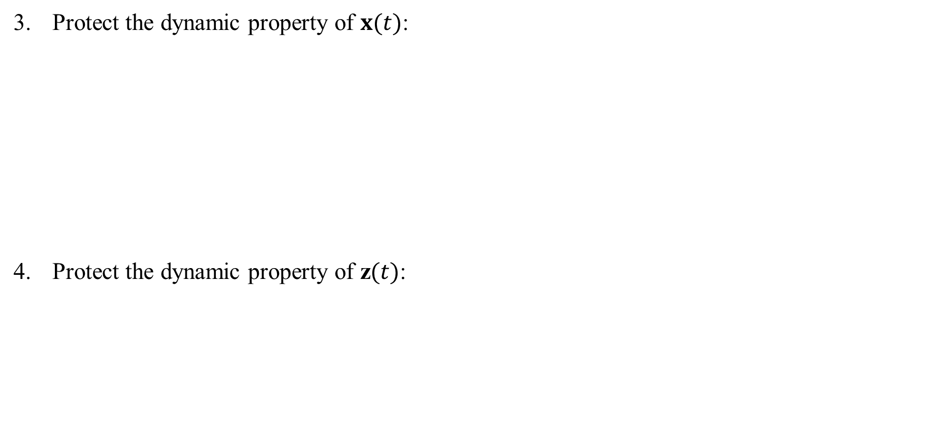
Main Method
Protect the dynamic property of $x(t)$:
Protect the dynamic property of z$(t)$:

Slide 16
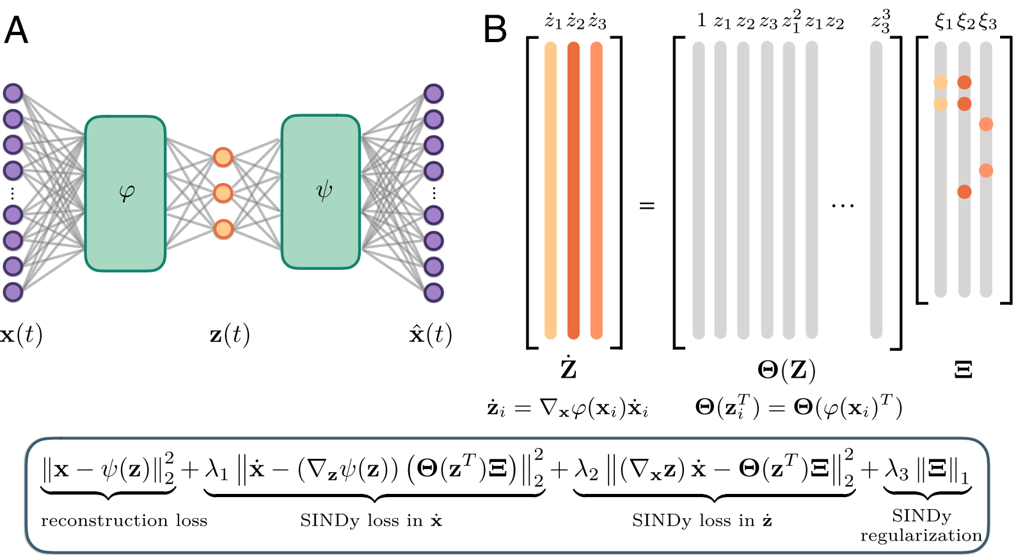
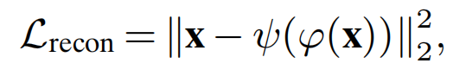
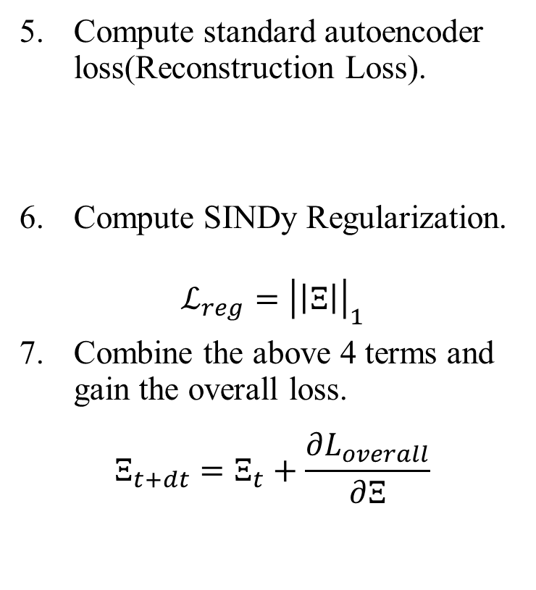
Main Method
Compute standard autoencoder loss(Reconstruction Loss).
Compute SINDy Regularization.
$$ℒ_{reg}={\left|\left|Ξ\right|\right|}_{1}$$
Combine the above 4 terms and gain the overall loss.
$$Ξ_{t+dt}=Ξ_{t}+\frac{∂L_{overall}}{∂Ξ}$$
Overall Loss!

Slide 17
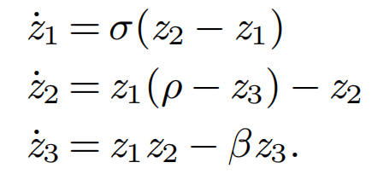
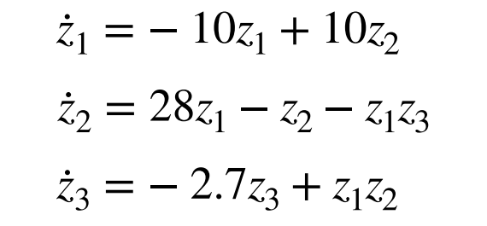
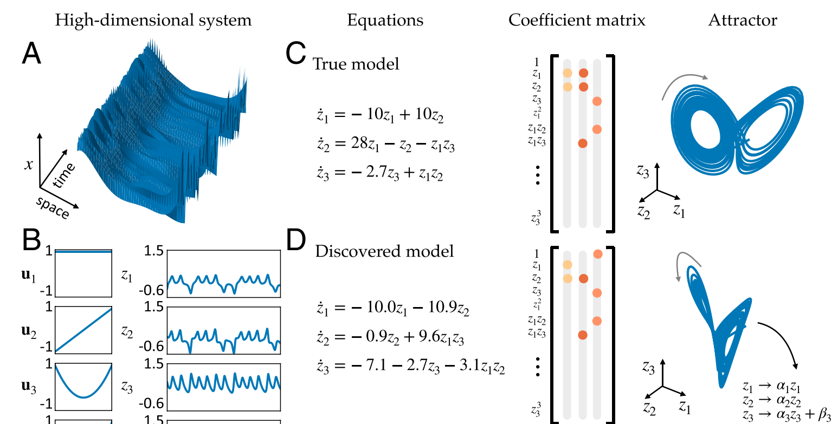
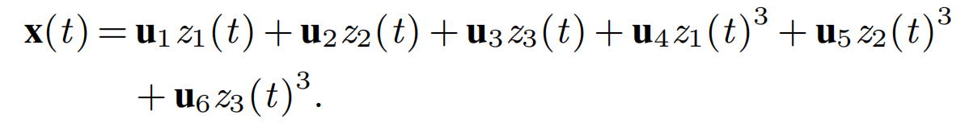
Experiments & Results - Chaotic Lorenz System
Goal: 从已经给定的Lorenz System数据进行训练，观察其能否还原动力系统。
Training Dataset:
a nonlinear combination of the
true Lorenz variables !
Recover the correct sparsity of nonlinear dynamics systems!

Slide 18
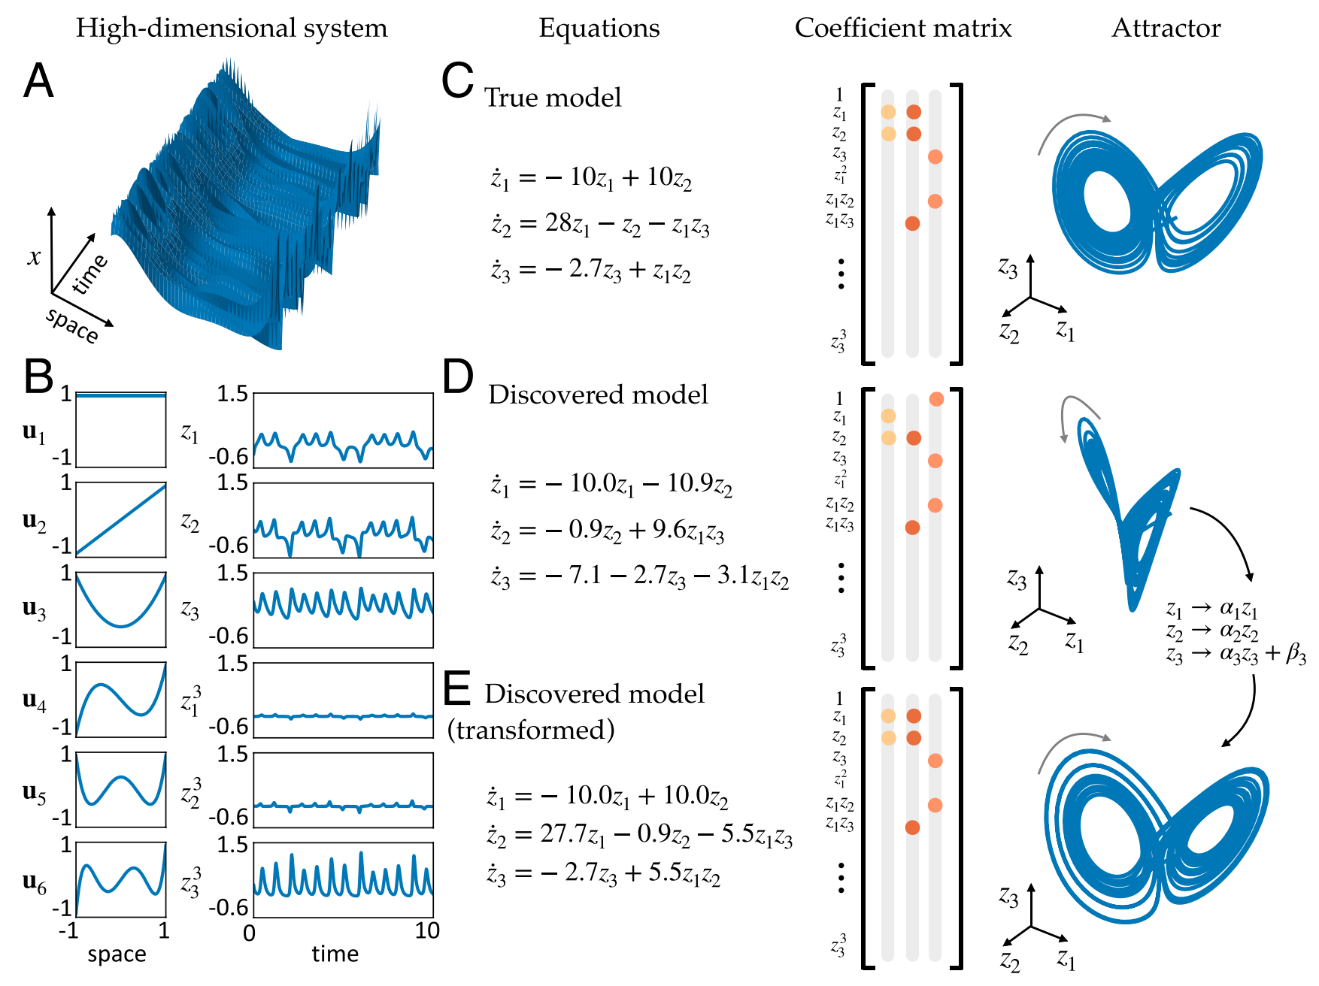
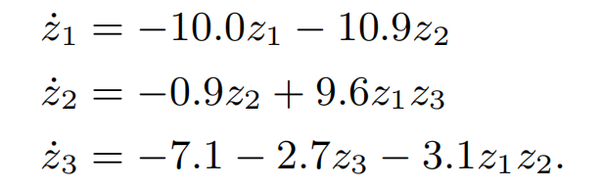
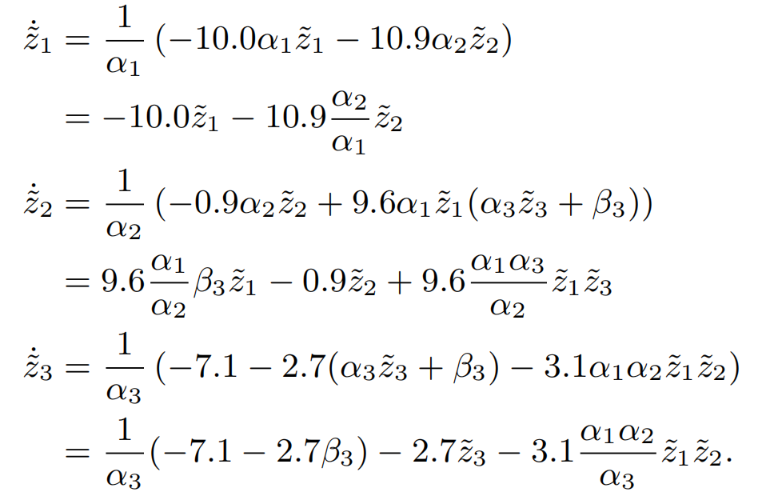
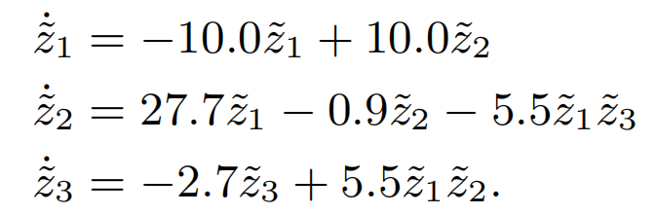
Experiments & Results - Chaotic Lorenz System
怎么把Discovered Model转换为和True Model一样的变量形式?
define an affine transformation
Substitute into original equation:

Slide 19



Experiments & Results - Nonlinear Pendulum
Dataset: generate a series of snapshot images with a 2D Gaussian centered at the center of mass, determined by the pendulum’s angle z.
模拟非线性摆的运动，生成摆角 $z$ 随时间变化的轨迹。
使用这些轨迹生成一系列包含2D高斯分布的图像，这些图像表示了摆在不同时间点的位置。
L2 error of Model 1:
$x$: $8×{10}^{−4}$
$\ddot{x}$: $3×{10}^{−4}$
$\ddot{z}$: $2×{10}^{−2}$

